Slide 1
Deep Learning for Computer Vision

Slide 2
What is Computer Vision (CV)?
Computer vision (CV) is the scientific field which defines how machines interpret the meaning of images and videos.
It is an area of machine learning dedicated to interpreting and understanding images and video.
It is used to help teach computers to “see” and to use visual information to perform visual tasks that humans can.
Computer vision algorithms analyse certain criteria in images and videos, and then apply interpretations to predictive or decision making tasks.
Computer vision models are designed to translate visual data based on features and contextual information identified during training. This enables models to interpret images and video and apply those interpretations to predictive or decision making tasks.
Image processing is not the same as computer vision. Image processing involves modifying or enhancing images to produce a new result. It can include optimizing brightness or contrast, increasing resolution, blurring sensitive information, or cropping. The difference between image processing and computer vision is that the former doesn’t necessarily require the identification of content.

Slide 3
Convolutional Neural Networks: The Foundation of Modern Computer Vision
Modern computer vision algorithms are based on convolutional neural networks (CNNs), which provide a dramatic improvement in performance compared to traditional image processing algorithms.
One of the first CNN architectures was AlexNet, which won the ImageNet visual recognition challenge in 2012.

Slide 4
How CNNs work
When an image is processed by a CNN, each base color used in the image (e.g. red, green, blue) is represented as a matrix of values.
These values are evaluated and condensed into 3D tensors (in the case of color images), which are collections of stacks of feature maps tied to a section of the image.
These tensors are created by passing the image through a series of convolutional and pooling layers, which are used to extract the most relevant data from an image segment and condense it into a smaller, representative matrix.
This process is repeated numerous times (depending on the number of convolutional layers in the architecture). The final features extracted by the convolutional process are sent to a fully connected layer, which generates predictions.

Slide 5
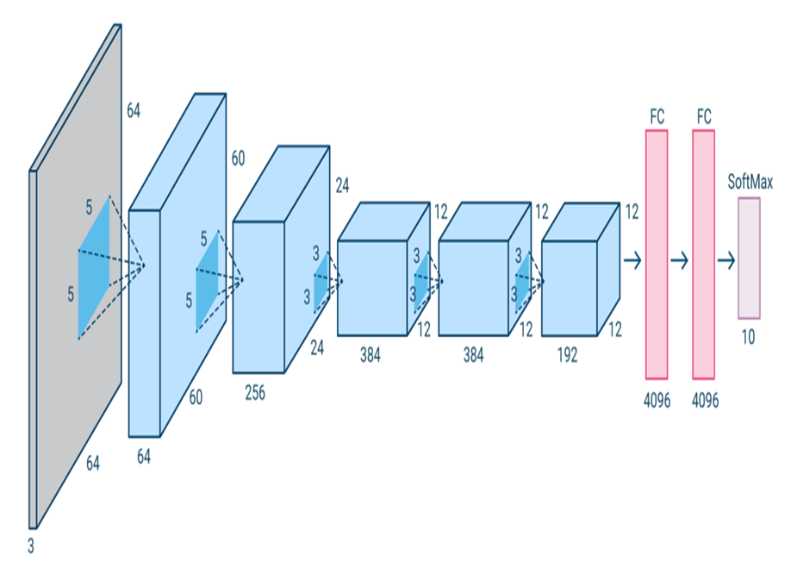
Deep Learning Architectures for Computer Vision
Alexnet
AlexNet is an architecture based on the earlier LeNet architecture. It includes five convolutional layers and three fully connected layers. AlexNet uses a dual pipeline structure to accommodate the use of two GPUs during training.

Slide 6
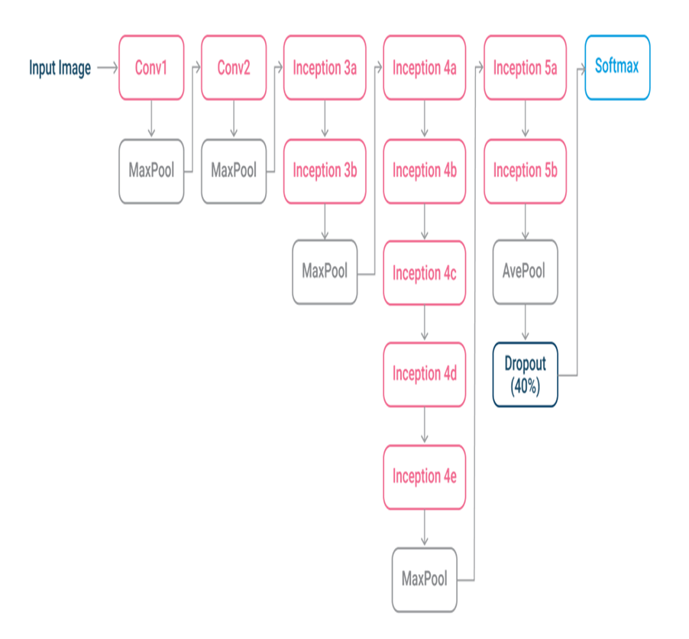
GoogleNet (2014)

Slide 7
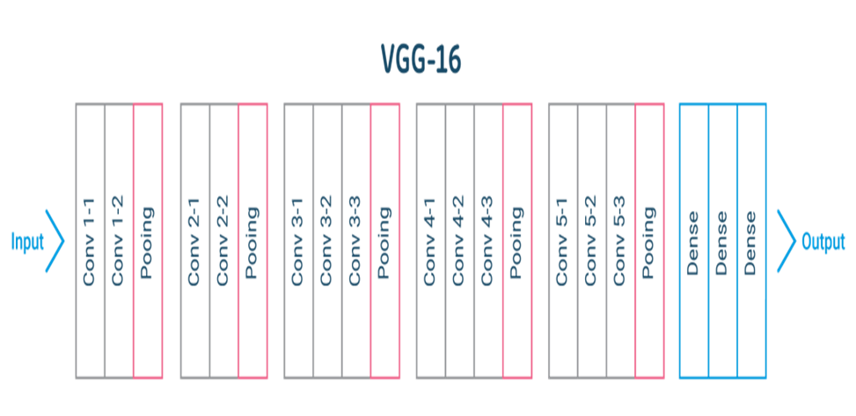
VGGNet (2014)

Slide 8
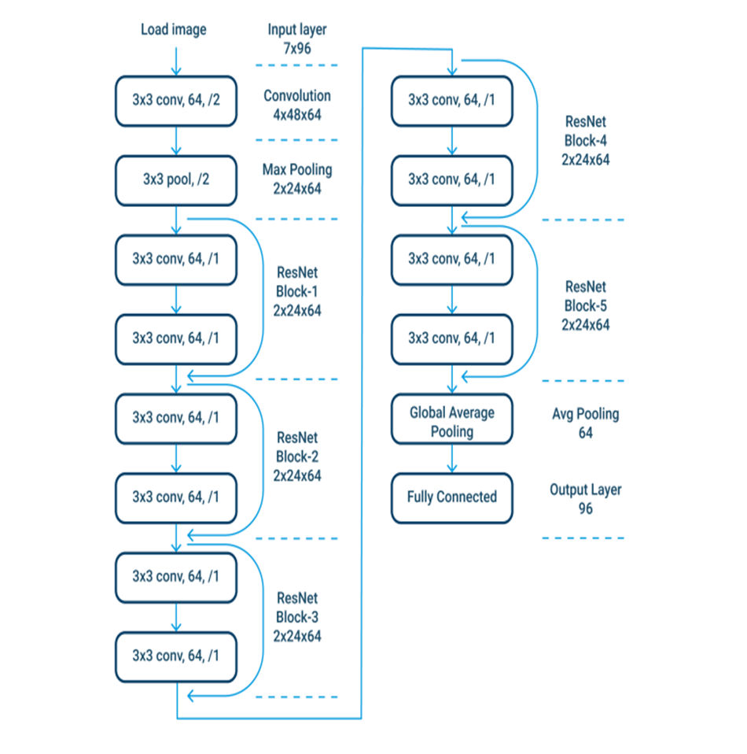
ResNet (2015)

Slide 9
Few ways deep learning is being used to improve computer vision.
Object detection
There are two common types of object detection performed via computer vision techniques:
Two-step object detection – the first step requires a Region Proposal Network (RPN), providing a number of candidate regions that may contain important objects. The second step is passing region proposals to a neural classification architecture, commonly an RCNN-based hierarchical grouping algorithm, or region of interest (ROI) pooling in Fast RCNN. These approaches are quite accurate, but can very slow.
One-step object detection – with the need for real time object detection, one-step object detection architectures have emerged, such as YOLO, SSD, and RetinaNet. These combine the detection and classification step, by regressing bounding box predictions. Every bounding box is represented with just a few coordinates, making it easier to combine the detection and classification step and speed up processing.

Slide 10
Localization and object detection
Image localization is used to determine where objects are located in an image. Once identified, objects are marked with a bounding box. Object detection extends on this and classifies the objects that are identified. This process is based on CNNs such as AlexNet, Fast RCNN, and Faster RCNN.
Localization and object detection can be used to identify multiple objects in complex scenes. This can then be applied to functionalities such as interpreting diagnostic images in medicine.

Slide 11
Semantic segmentation
Semantic segmentation, also known as object segmentation, is similar to object detection except it is based on the specific pixels related to an object. This enables image objects to be more carefully defined and does not require bounding boxes. Semantic segmentation is often performed using fully convolutional networks (FCN) or U-Nets.
One popular use for semantic segmentation is for training autonomous vehicles. With this method, researchers can use images of streets or throughways with accurately defined boundaries for objects.

Slide 12
Pose estimation
Pose estimation is a method that is used to determine where joints are in a picture of a person or an object and what the placement of those joints indicates. It can be used with both 2D and 3D images. The primary architecture used for pose estimation is PoseNet, which is based on CNNs.
Pose estimation is used to determine where parts of the body may show up in an image and can be used to generate realistic stances or motion of human figures. Often, this functionality is used for augmented reality, mirroring movements with robotics, or gait analysis.

Slide 13
CNN Image Classification with Keras
Step 1: Choose a Dataset
Choose a dataset of your interest or you can also create your own image dataset for solving your own image classification problem. An easy place to choose a dataset is on kaggle.com.
Libraries needed
  from keras.models import Sequential
  import tensorflow as tf
  import tensorflow_datasets as tfds
  tf.enable_eager_execution()
  from keras.layers.core import Dense, Activation, Dropout, Flatten
  from keras.layers.convolutional import Convolution2D, MaxPooling2D
  from keras.optimizers import SGD, RMSprop, adam
  from keras.utils import np_utils
  from sklearn.tree import DecisionTreeClassifier # Import Decision Tree Classifier
  from sklearn import metricsfrom sklearn.utils import shuffle
  from sklearn.model_selection import train_test_splitimport matplotlib.image as mpimg
  import matplotlib.pyplot as plt
  import numpy as np
  import os
  import cv2
  import randomfrom numpy import *
  from PIL import Image
  import theano

Slide 14
Step 2 : Prepare Dataset for Training
Preparing our dataset for training will involve assigning paths and creating categories(labels), resizing our images.
Resizing images into 200 X 200
path_test = "/content/drive/My Drive/semester 5 - ai ml/datasetHomeAssign/TRAIN"
CATEGORIES = ["EOSINOPHIL", "LYMPHOCYTE", "MONOCYTE", "NEUTROPHIL"]
print(img_array.shape)IMG_SIZE =200
new_array = cv2.resize(img_array, (IMG_SIZE, IMG_SIZE))

Slide 15
Create Training Data
Training is an array that will contain image pixel values and the index at which the image in the CATEGORIES list.
training = []def createTrainingData():
for category in CATEGORIES:
path = os.path.join(path_test, category)
class_num = CATEGORIES.index(category)
for img in os.listdir(path):
img_array = cv2.imread(os.path.join(path,img))
new_array = cv2.resize(img_array, (IMG_SIZE, IMG_SIZE))
training.append([new_array, class_num])createTrainingData()

Slide 16
Step 4: Shuffle the Dataset
random.shuffle(training)
Step 5: Assigning Labels and Features
This shape of both the lists will be used in Classification using the NEURAL NETWORKS.
  X =[]
  y =[]for features, label in training:
  X.append(features)
  y.append(label)
  X = np.array(X).reshape(-1, IMG_SIZE, IMG_SIZE, 3)

Slide 17
Step 6: Normalising X and Converting Labels to Categorical Data
  X = X.astype('float32')
  X /= 255
  from keras.utils import np_utils
  Y = np_utils.to_categorical(y, 4)
  print(Y[100])
  print(shape(Y))
Step 7: Split X and Y for Use in CNN
X_train, X_test, y_train, y_test = train_test_split(X, y, test_size = 0.2, random_state = 4)

Slide 18
Step 8: Define, Compile and Train the CNN Model
Step 9: Accuracy and Score of Model
  score = model.evaluate(X_test, y_test, verbose = 0 )
  print("Test Score: ", score[0])
  print("Test accuracy: ", score[1])

Slide 19
Neural Style Transfer

Slide 20
It is an algorithm where we combine the style of one input image with the content of another input image to generate a new image with the style of the first and the content of the second image.
The content of an image consists of the objects, the shapes, and the overall structure and geometry of the given image.
On the other hand, the style of an image has to do with the textures, the colors, and the patterns. The style of this image is unique and is related to the artistic style.
In other words, Neural style transfer is an optimization technique used to take two images, a content image and a style reference image (such as an artwork by a famous painter), and blend them so the output image looks like the content image, but “painted” in the style of the style reference image.

Slide 21
The algorithm can be divided into the following steps:
1. Choose the content image and the style image.
2. Load a pre-trained convolutional neural network(CNN) like VGG-19, GoogLeNet, or ResNet50. These networks are already trained on a huge number of images from various domains and are able to capture the important characteristics of an input image. So, they can also extract both the style and the content of the input images.
3. The next step is to define the loss functions that will guide the training pipeline into generating our desired image

Slide 22
Two loss functions
The content loss function measures the difference between the features of the generated image and the features of the content image.
To calculate the content cost, we apply the mean square difference between matrices generated by the content layer, when we pass the generated image and the original image.
Let p and x be the original image and the image that is generated, and P and F are their respective feature representation in layer l. We then define the squared-error loss between the two feature representations

Slide 23
The style loss function measures the difference between the features of the generated image and the features of the style image
To calculate the style cost, we will first calculate the gram matrix.
The gram matrices calculation involves calculating the inner product between the vectorized feature maps of a particular layer.
Here G_{ij} (l) represents the inner product between vectorized features i,j of layer l.

Slide 24
Now to calculate the loss from a particular, we will find the mean square difference of gram matrices calculated from the feature vectors of the style image and the generated image. This then weighted to the layer weighing factor.
Let a and x be the original image and the generated image, and Al and Gl their respective style representation (gram matrices) in layer l. The contribution of layer l to the total loss is then:

Slide 25
Therefore, total style loss will be:
Total Loss:
Total loss is the linear combination of style and content loss
Where α and β are the weighting factors for content and style reconstruction, respectively.

Slide 26
4. The generated image is first initialized with the same pixels as the content image. During training, it is gradually optimized to match the style of reference images retaining only the content of image
5. The total loss function is defined as the weighted sum of the content and the style loss function, and the whole procedure is optimized using an Adam optimizer.
6. Finally, the whole procedure is repeated for many epochs until we end up with the desired output image

Slide 27
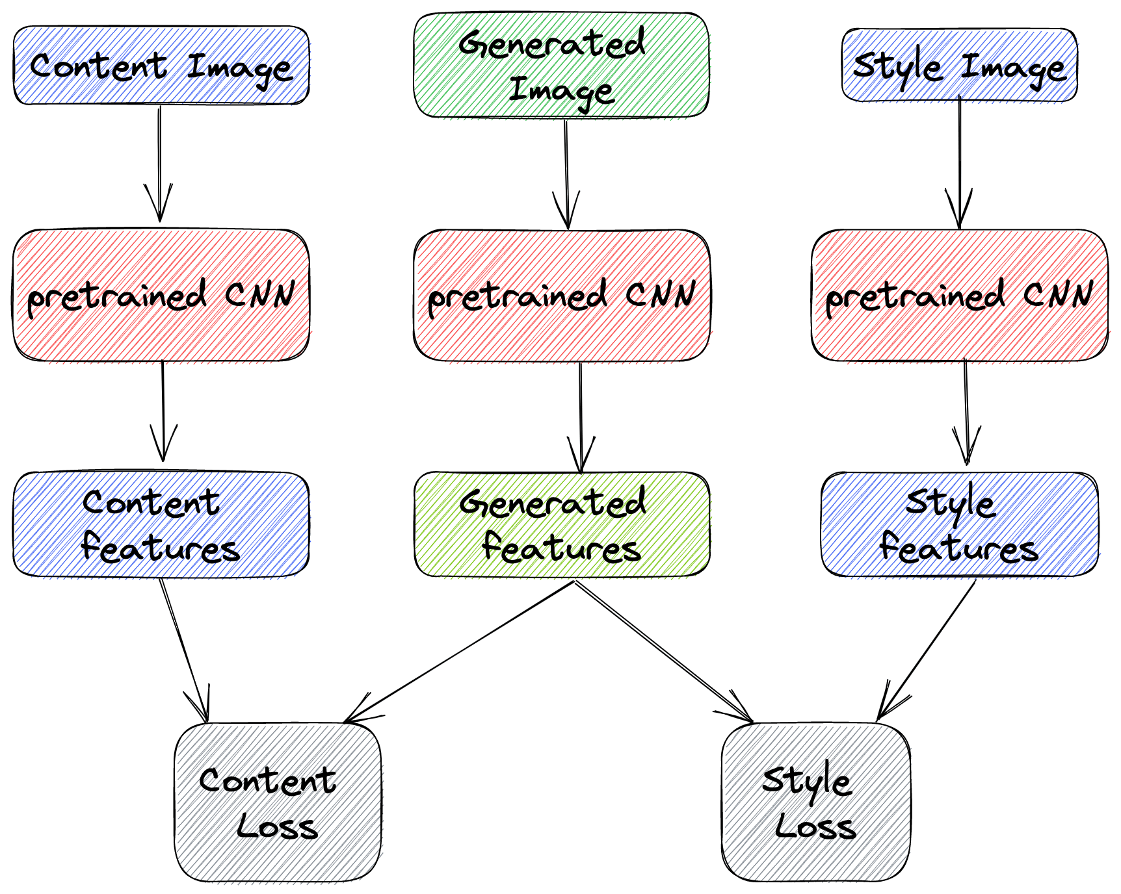
Many times as an extra step, the generated image is further processed to increase its visual quality using various visual filters.

